Slide 1
Love’s Hidden Journey
Happy Six Months Jigglypuff

Slide 2
Contents of Affection
01
02
03
04
Love Sparks
Nostalgic Moments
Sweet memories and meaningful moments.
Reliving treasured moments that brought us closer.
Joyful Jests
Heartfelt Hilarity
Laughter and play with fun challenges and dares.
Ending with love, laughter.

Slide 3
Opening My Heart
I'm not sure where to begin, and I know I've said this before, but I truly love you more than anything in this world. From the very first day I imagined us together, I felt a mix of happiness and fear—I was so happy but scared of losing you. I wanted everything to be perfect, and to my surprise, these past six months have been the best I've ever had. You are the perfect person, and there isn't a single thing I would want to change about you.
I love everything about you. More than anything, I just want to make this work and build a future together. I know it sounds a bit forward, but I just want you to play this cute little game I thought you'd enjoy, to show you how much I love you. I want us to reminisce about all the special moments we've shared and go on dates with cute gifts, sweet quotes, and little surprises. I love you so much.

Slide 4
01
Love Sparks
Sweet memories and meaningful moments.

Slide 5
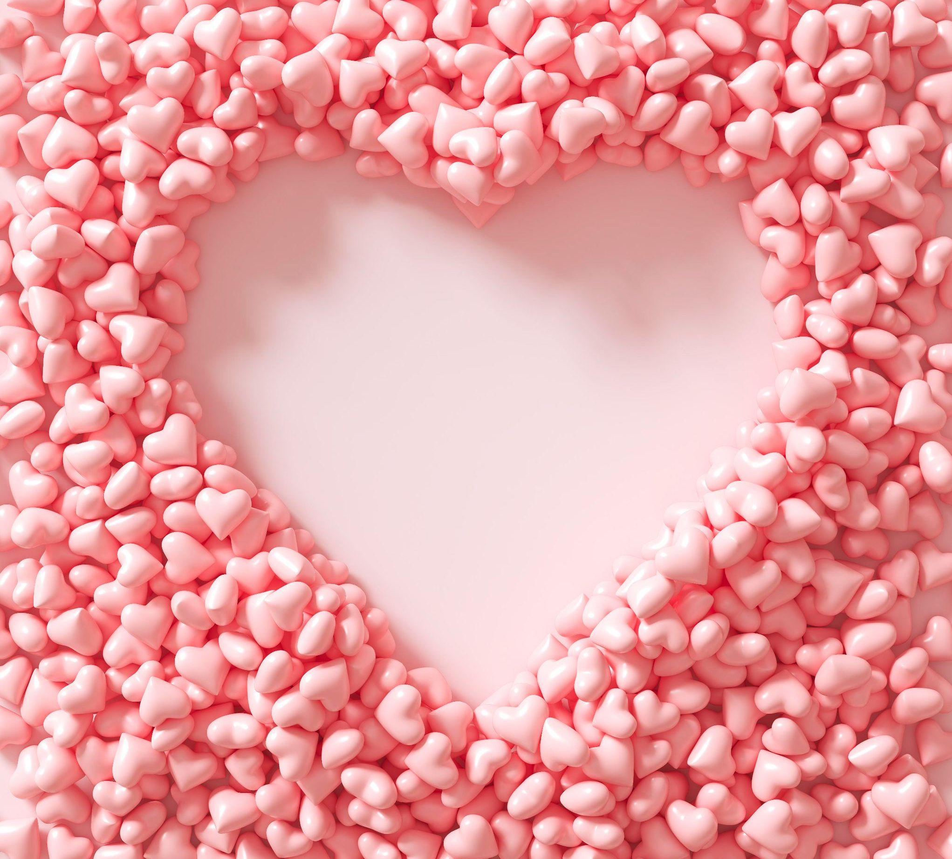
Fill my heart
Do you know what helps you make your point clear? Lists like this one:
When did you first realize you were in love with me?
Send me a selfie of you at this moment
Which anniversary did we miss cutting a cake ?

Slide 6
Find the spark
Blooms
Lovely
Look where petals bloom and leaves grow tall, the biggest beauty waits for you, standing proud and all.
Amidst the love that fills this space, where hearts surround and warm embrace, your gift awaits, in a place so sweet, where love and passion constantly meet.

Slide 7
02
Nostalgic
Moments

Slide 8
Three dreams
Focus
Heartbeat
On our way from Alesio, you wanted to stay in a place where we can enjoy luxury and comfort, which one would it be?
Can you tell me a moment when my heart was pounding after seeing you, because you looked absolutely stunning?
Royal
Of all the places we've been, is there a specific day or moment that made you feel like a queen, where everything just felt perfect?

Slide 9
03 Joyful Jests

Slide 10
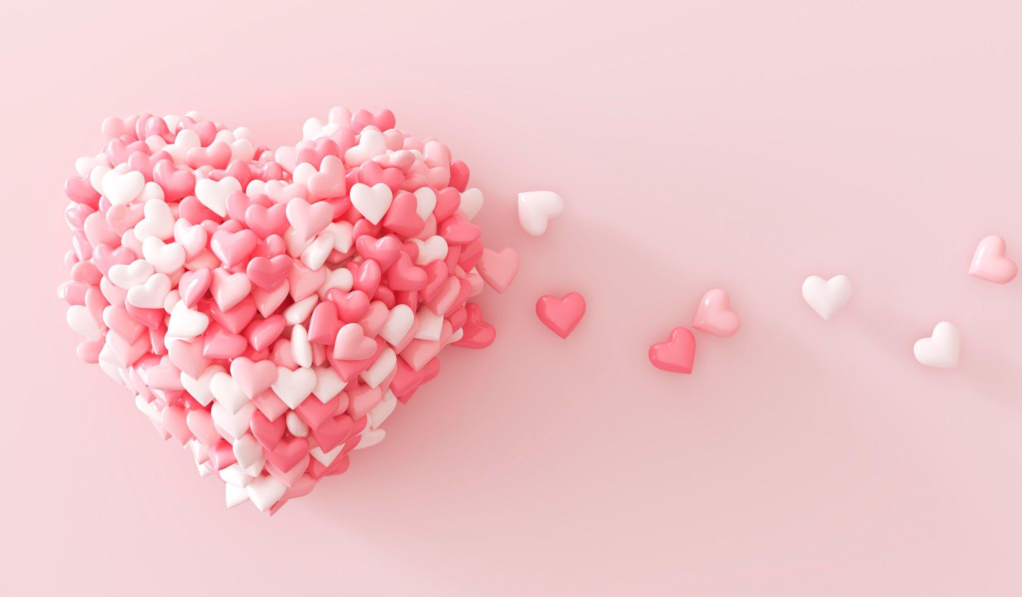
A picture is worth a thousand words

Slide 11
Places of Love
Single
United
Next Stop
Alone you start, but love is near, search the space where hearts appear.
Guess where we unite, hand in hand, ready for the world’s delight.
Guess where we’ll go, where dreams unfold and new memories grow

Slide 12
Our Love Story
01
06
Lindale
Taos Ski Valley
From love cake to arcade fun, to our first treehouse, memories begun.
Sudden big trip, Taos ski for the first time, and a white sand kiss.
02
05
RH Rooftop
Lenox Square
A royal date, a ship to sleep, and gifts we keep.
Nervous cake cutting, a simple date, and shopping we celebrate.
03
04
Cake in Flight
Planetarium
26 hours of joy, a small cake, and time so sweet we’ll always take.
Open-top car ride, love’s planetarium, and Arkansas bridge side.

Slide 13
04 Heartfelt Hilarity

Slide 14
Love & Laughter
Poem
Kiss
Write me a short poem about us
Kiss me for one minute long
Pick one thing in less than 10 seconds!
Pick one thing in less than 10 seconds!
Piggyback
Song
Give me a piggyback ride for 30 seconds!
Sing a line from a song that reminds you of us

Slide 15
Love you
99,99,90,00 km
You are my moon, my stars, my everything
No matter how far, my heart is always with you

